Slide 1
Introduction to Banking Concepts

Slide 2
Banking Concepts Industry Terminology
Electronic funds transfer or EFT refers to the computer-based systems used to perform financial transactions electronically.
The term is used for a number of different concepts:
Cardholder-initiated transactions, where a cardholder makes use of a payment card
Electronic payments by businesses, including salary payments
Electronic check (or cheque) clearing

Slide 3
Banking Concepts Industry Terminology
EFT Participants
ATM networks and owners
Information processors
Card organizations
Retailers
Brokerage firms
Hardware and software manufacturers
Government agencies
Industry consultants
Security firms

Slide 4
Banking Concepts Industry Terminology
PAN (Personal Account Number)
ATM (Automated Teller Machine)
POS (Point Of Sale)
PIN (Personal Identification Number)
Issuer (The Authorizer)
Acquirer (The Initiator)
On-us Transactions (Our Own Customers)
Off-us Transactions (Other Bank Customers)
Not On-Us
Remote On-Us
ISO Message (International Organization for Standardization)

Slide 5
Banking Concepts Industry Terminology
Deposits
Withdrawals
Balance Inquiry transactions
Message to Institution transactions
Log only transactions
Pin Change transactions
Statement Print transactions
User Defined transactions

Slide 6


Banking Concepts Initial ATM Setup
ATM <–> Branch
ATM1, ATM2, ATM3<-> Branch
Standalone
PC
BRANCH D/B
Standalone
PC
BRANCH D/B

Slide 7
Banking Concepts Switching Server
What is a Switch?
Software module
Route the information between sources and destinations
Processing transactions
Examples
- BASE24
- CONNEX
- Oasis
- Sparrow

Slide 8
Banking Concepts Purpose of Switch Software
Switch is a routing facility of information between sources and destinations Processes Transactions
Switch process transactions from ATM and Merchant's Point of Sale terminals
Switch process requests from financial institutions and their branches
Switch process requests from financial networks and internet

Slide 9
Banking Concepts Devices Connected to a Switch Server
ATM (Automated Teller Machine)
HSM (Host Security Module)
Bank Host (Bank Database Server)
POS (Point of Sale)
Network Access Controller
Connectivity to External Networks

Slide 10
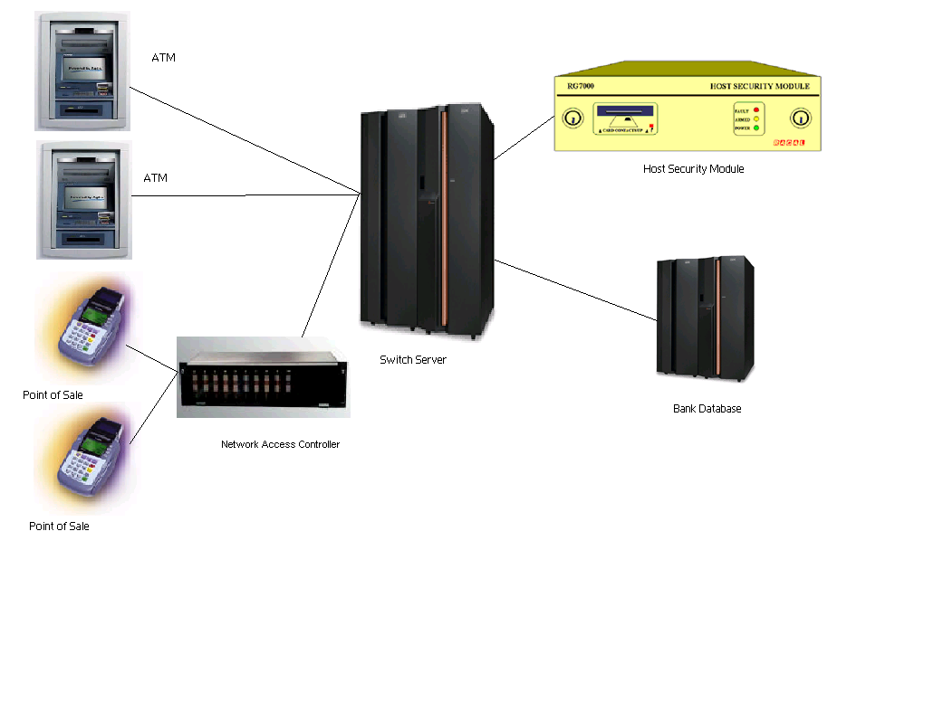
Banking Concepts Scenario of a Switch Network

Slide 11
Banking Concepts Switch Modules
Terminal Handler (ATM/POS)
Authorization Module
Security Module
Host Interface Module
Interchange Interface Module
(MasterCard, visa)

Slide 12
Banking Concepts Types of Switch
Stand-Alone Switch
* Owned by the Institution
Inter-Regional Switch
* Interconnected with in the country
Inter-Network Switch
* Interconnected Internationally

Slide 13
Banking Concepts Stand-Alone Switch

Slide 14
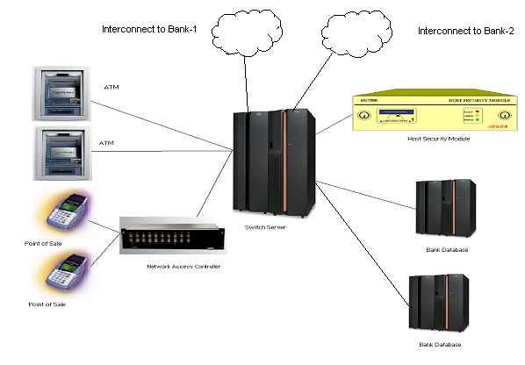
Banking Concepts Inter-Regional Switch

Slide 15
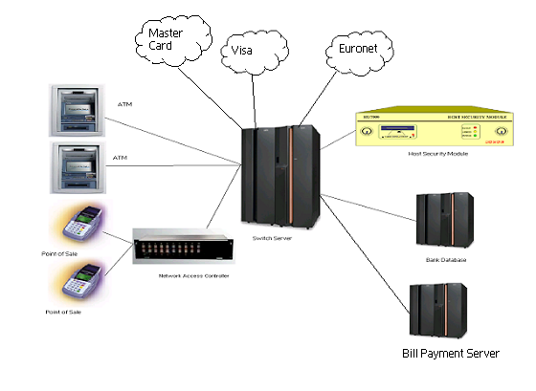
Banking Concepts Inter-Network Switch
AMEX

Slide 16

Banking Concepts
Message Transfer
Txn.
Closes
1
Inserts
Card
10
SwitchServer
ATM
2
Switch
Product
7
Bank Host
(DataBase)
9
8
ATM – Switch
(91X / NDC+)
Message
Switch – HSM
(HSM Message)
Switch – Bank Host
(ISO Message)
3
4
5
Host
Security
Module
6

Slide 17
Banking Concepts CARDS
Classification of Cards
ATM Card
Global Card
* Global Debit
* Global Credit

Slide 18
Banking Concepts Physical Characteristics
The magnetic stripe consists of three tracks on which information is stored via a encoding device.
Track 1.
Track 2.
Track 3.
Signature panel

Slide 19
Banking Concepts
TRACK2
Primary account number (PAN), left justified (up to 19 digits)
Field separator (=)
Member number
Country code (if present; 3 digits)
Expiration date (YYMM)
PIN verification data

Slide 20
Banking Concepts
TRANSACTION AUTHROIZATION
EFT transactions require communication between a number of parties.
When a card is used at a merchant or ATM, the transaction is first routed to an acquirer, then through a number of networks to the issuer where the cardholder's account is held.

Slide 21
Banking Concepts
The authorization carried out based on the parameters for an institution and controls and returns responses to the source of the transaction request.

